Slide 1
Instacart Market Basket Analysis
june, 2020
By: Anu Kashyap

Slide 2
Agenda
Background & Objectives
Data
Exploratory Data Analysis
Prediction Models
Recommendations
Lyft’s overall business objective

Slide 3
Background & Objectives
Background
Instacart operates an online grocery delivery and pick-up service. Orders are fulfilled and delivered by an Instacart personal shopper, who picks, packs, and delivers the order within the customer's designated time frame
Currently they use transactional data to develop models that predict which products a user will buy again, try for the first time, or add to their cart next during a session
Through a competition, Instacart is challenging the Kaggle community to use this anonymized data on customer orders over time to predict which previously purchased products will be in a user’s next order.
Problem Statement & Objective
Problem statement: Which products will an Instacart consumer purchase again?
The overall objective is to predict products that a user will buy again, try for the first time or add to cart next during a session
Instacart currently uses XGBoost, word2vec and Annoy in production on similar data to sort items for users to “buy again”
This data, and the algorithms trained upon it, are enabling Instacart to revolutionize how consumers discover and purchase groceries
This helps Instacart make the right product recommendations to the customer, thereby, making the shopping experience more convenient for consumer

Slide 4
Data
The dataset for this competition is a relational set of files describing customers' orders over time. The dataset is anonymized and contains a sample of over 3 million grocery orders from more than 200,000 Instacart users. The datasets are:
aisles.csv: contains the aisle_id and aisle_name of a product
departments.csv: contains the department_id and department_name of a product
order_products__prior.csv: contains previous order contents for all customers. 'reordered' indicates that the customer has a previous order that contains the product
order_products__train.csv:
orders.csv: Contains information about which set (prior, train, test) an order belongs. Need to predict reordered items only for the test set orders. 'order_dow' is the day of week
products.csv: contains mapping between product, aisle and department
Data Source: https://www.kaggle.com/c/airbnb-recruiting-new-user-bookings/data

Slide 5
Exploratory Data Analysis

Slide 6
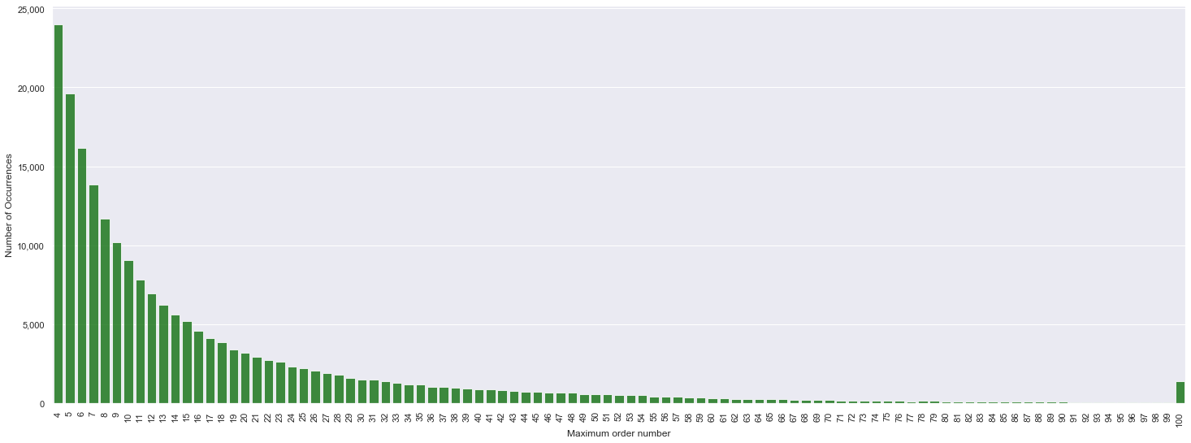
Orders By Order Number
All users have at least 4 orders and at most 100 orders
Notes:
(1) Cancellation rate = # of Cancelled rides / Total # of rides
(2) Revenue = Rider paid amount after excluding cancellation fee

Slide 7
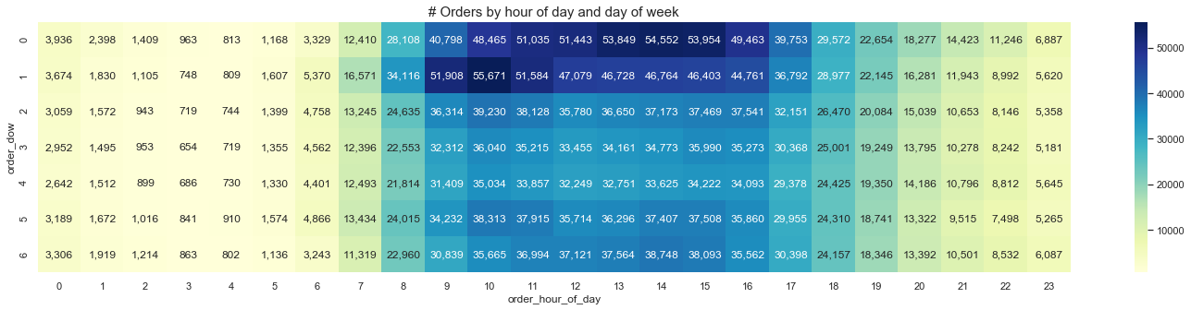
Order Frequency
Saturday afternoon and Sunday mornings/afternoons have high order frequencies

Slide 8
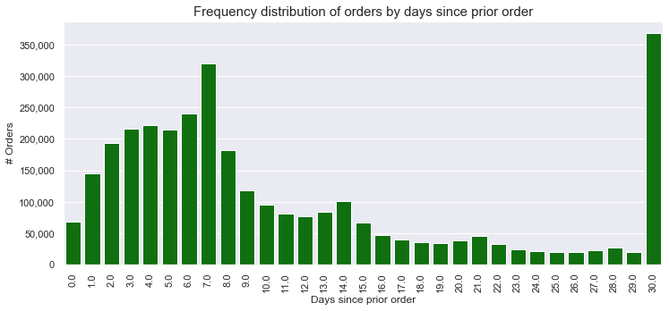
Order Distribution By Days Since Prior Order
Customers order once in every week (peak at 7 days) or once in a month (peak at 30 days)
Also observed smaller peaks at 14, 21 and 28 days (weekly intervals)

Slide 9
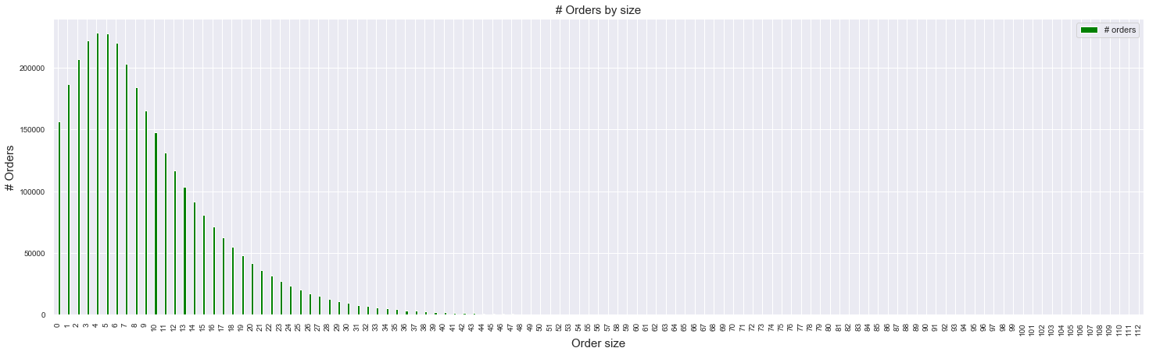
Order Size
Maximum order size is 5, with most orders with 3-7 products

Slide 10
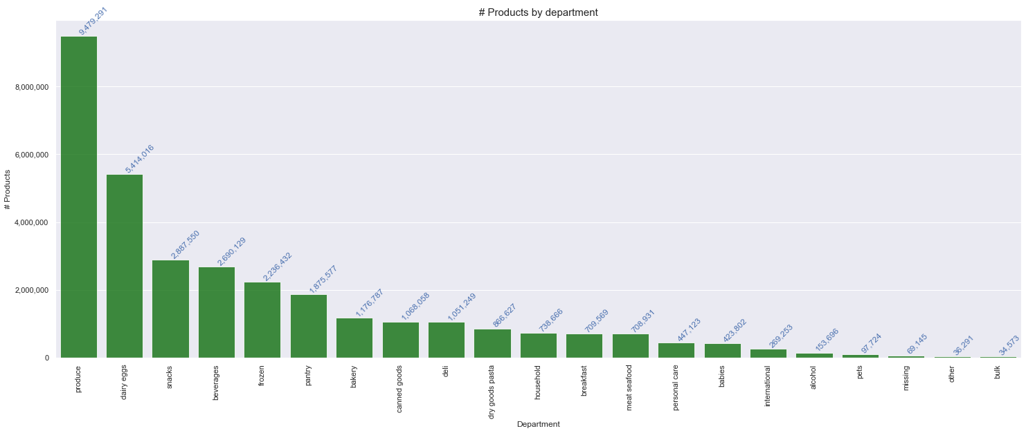
Products By Department
Most products are ordered from the Produce department (Fruits and vegetables)

Slide 11
Top 20 Products by # Orders
Most of the top 20 ordered products are either fruits and vegetables
# | Aisle | Department | Product | # Orders | Reorder Ratio
1 | fresh fruits | produce | Banana | 472,565 | 84.4%
2 | fresh fruits | produce | Bag of Organic Bananas | 379,450 | 83.3%
3 | fresh fruits | produce | Organic Strawberries | 264,683 | 77.8%
4 | packaged vegetables fruits | produce | Organic Baby Spinach | 241,921 | 77.3%
5 | fresh fruits | produce | Organic Hass Avocado | 213,584 | 79.7%
6 | fresh fruits | produce | Organic Avocado | 176,815 | 75.8%
7 | fresh fruits | produce | Large Lemon | 152,657 | 69.6%
8 | fresh fruits | produce | Strawberries | 142,951 | 69.8%
9 | fresh fruits | produce | Limes | 140,627 | 68.1%
10 | milk | dairy eggs | Organic Whole Milk | 137,905 | 83.0%
11 | packaged vegetables fruits | produce | Organic Raspberries | 137,057 | 76.9%
12 | fresh vegetables | produce | Organic Yellow Onion | 113,426 | 69.7%
13 | fresh vegetables | produce | Organic Garlic | 109,778 | 68.0%
14 | fresh vegetables | produce | Organic Zucchini | 104,823 | 68.8%
15 | packaged vegetables fruits | produce | Organic Blueberries | 100,060 | 62.9%
16 | fresh vegetables | produce | Cucumber Kirby | 97,315 | 69.2%
17 | fresh fruits | produce | Organic Fuji Apple | 89,632 | 71.2%
18 | fresh fruits | produce | Organic Lemon | 87,746 | 69.0%
19 | fresh fruits | produce | Apple Honeycrisp Organic | 85,020 | 73.5%
20 | packaged vegetables fruits | produce | Organic Grape Tomatoes | 84,255 | 65.6%

Slide 12
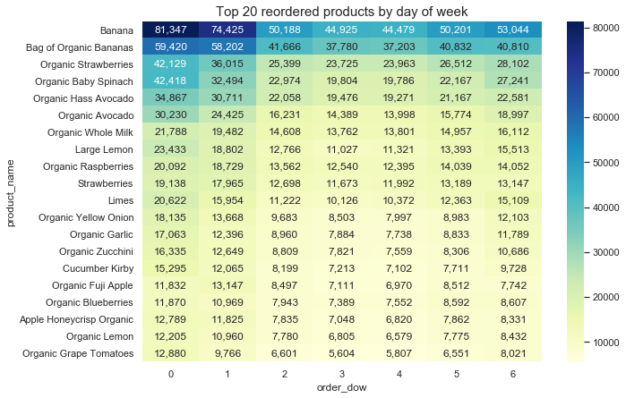
Product By Order Day Of Week
Banana is the most ordered and reordered product and mostly ordered on Saturday and Sunday

Slide 13
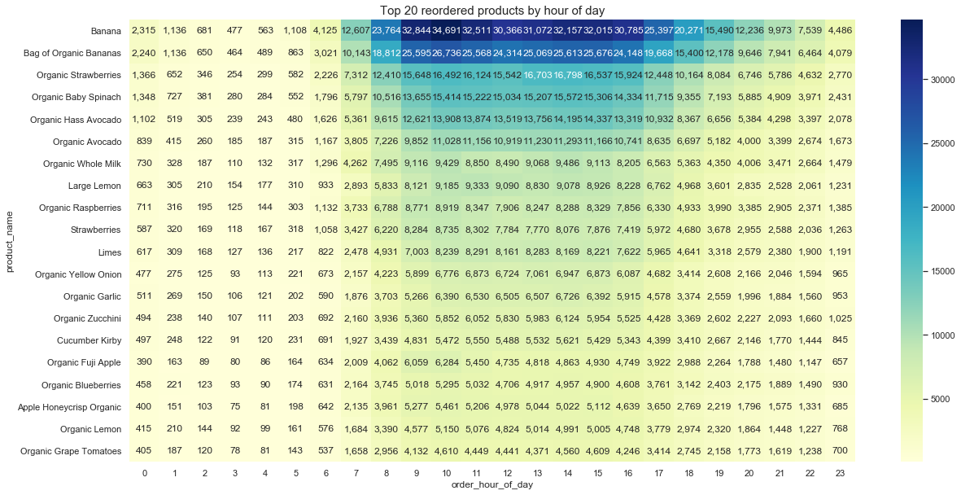
Product By Order Hour Of Day
Banana is the most ordered and reordered product and mostly ordered during afternoon hours

Slide 14
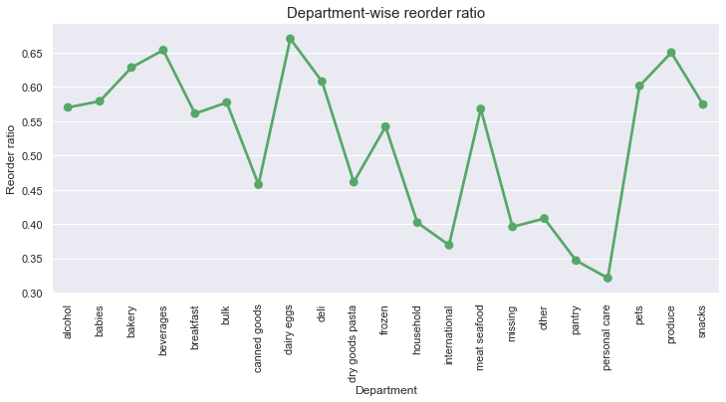
Product Reorder Ratio
Dairy eggs department has highest reorder ratio and Personal care has the lowest

Slide 15
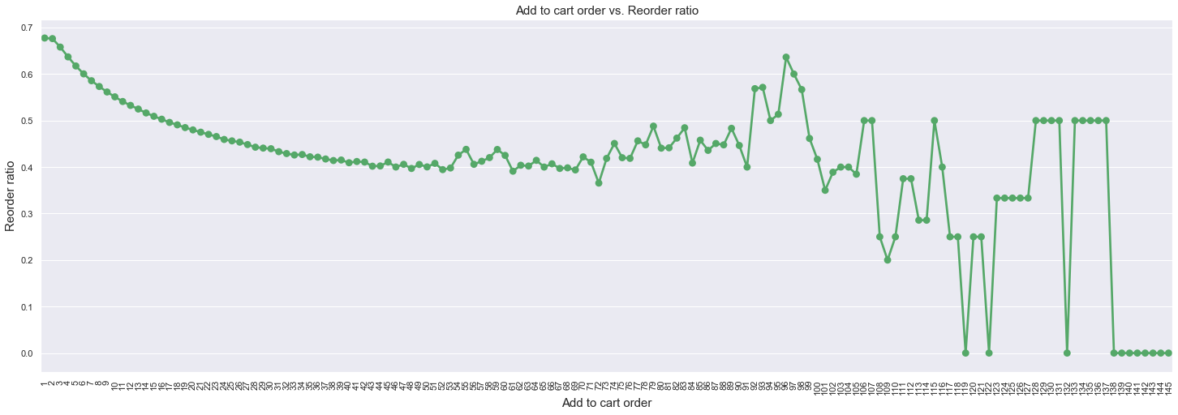
Reorder Ratio by Add to Card Order
The products that are added to the cart initially are more likely to be reordered again compared to the ones added later which makes sense as we tend to first order all the products we buy frequently and then search for new products

Slide 16
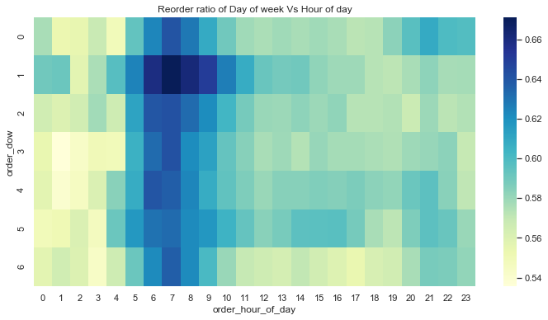
Reorder Ratio by Order Day of Week and Hour of Day
Most of the reordered or frequently ordered products are ordered in the early morning hours

Slide 17
Independent Variables
One hot encoding is used to convert categorical variables to dummy variables
# | Variable name | Description | Type
1 | user_tot_orders | Number of total orders for a user (user level) | Numeric
2 | user_tot_prods | Total number of items a user bought (user level) | Numeric
3 | user_tot_dist_prods | Number of distinct products a user bought (user level) | Numeric
4 | user_avg_days_bet_orders | Average number of days between orders for a user (user level) | Numeric
5 | user_avg_order_size | Average number of items in a user’s order (user level) | Numeric
6 | order_hour_of_day | Hour of the day for the order for which we need to predict products (order level) | Numeric
7 | days_since_prior_order | # of days since the prior order for the order for which we need to predict products (order level) | Numeric
8 | days_since_ratio | days_since_prior_order/user_avg_days_bet_orders (order level) | Numeric
9 | department | Department name of the product (order level) | Categorical
10 | prod_ordered | # of times the product has been ordered (product level) | Numeric
11 | prod_reordered | # of times the product has been reordered (product level) | Numeric
12 | prod_reorder_rate | prod_reordered / prod_ordered | Numeric
13 | uxp_tot_orders | Total number of orders at user X product level | Numeric
14 | uxp_order_rate | uxp_tot_orders / user_tot_orders | Numeric
15 | uxp_avg_pos_in_cart | Average position in cart at user X product level | Numeric
16 | uxp_reorder_rate | uxp_reordered/user_reorderd_prods | Numeric
17 | uxp_orders_since_last_order | # orders since the user ordered this product (Total # of orders for a user – order number of the product when it was ordered by the user) | Numeric
18 | uxp_delta_hour_vs_last | order_hour_of_day - | Numeric

Slide 18
Comparison Between Prediction Models
Light GBM classification gives the highest accuracy on the Kaggle hold out set at 37.8%
 | XGBoost | Light GBM | Random Forest
Dependent variable | Predicts whether a product will be ordered in the user’s next ordered | Predicts whether a product will be ordered in the user’s next ordered | Predicts whether a product will be ordered in the user’s next ordered
Hyperparameter Tuning Method | Randomized Search | Randomized Search | Grid Search
Optimal Hyperparameters | objective: ‘binary:logistic’ n_estimators: 50 max_depth: 5 learning_rate: 0.2 | boosting_type: 'gbdt’ objective: 'binary’ metric: {'binary_logloss’} num_leaves: 96 max_depth: 10 feature_fraction: 0.9 bagging_fraction: 0.95 bagging_freq: 5 | max_dept: 7 n_estimators: 70 max_features: ‘auto’
Accuracy (Train set) | 90.1% | - | 90.7%
Accuracy (Hold out set on Kaggle) | 37.4% | 37.8% | 17.4%

Slide 19
Variable Importance
uxp_order_rate and uxp_orders_since_last_order are the top two predictors
# | Variable name | Importance | Description
1 | uxp_order_rate | 44.7% | uxp_tot_orders / user_tot_orders
2 | uxp_orders_since_last_order | 17.9% | # orders since the user ordered this product (Total # of orders for a user – order number of the product when it was ordered by the user)
3 | uxp_reorder_rate | 9.9% | uxp_reordered/user_reorderd_prods
4 | uxp_tot_orders | 7.3% | Total number of orders at user X product level
5 | prod_reorder_rate | 4.9% | prod_reordered / prod_ordered
6 | department | 3.8% | Department name of the product (order level)
7 | days_since_prior_order | 2.6% | # of days since the prior order for the order for which we need to predict products (order level)
8 | days_since_ratio | 1.4% | days_since_prior_order/user_avg_days_bet_orders (order level)
9 | prod_reordered | 1.3% | # of times the product has been reordered (product level)
10 | uxp_delta_hour_vs_last | 1.2% | order_hour_of_day -
11 | user_tot_prods | 0.8% | Total number of items a user bought (user level)
12 | user_avg_days_bet_orders | 0.7% | Average number of days between orders for a user (user level)
13 | user_avg_order_size | 0.7% | Average number of items in a user’s order (user level)
14 | user_tot_dist_prods | 0.7% | Number of distinct products a user bought (user level)
15 | user_tot_orders | 0.7% | Number of total orders for a user (user level)
16 | prod_ordered | 0.6% | # of times the product has been ordered (product level)
17 | uxp_avg_pos_in_cart | 0.6% | Average position in cart at user X product level
18 | order_hour_of_day | 0.2% | Hour of the day for the order for which we need to predict products (order level)

Slide 20
Insights
Out of the three classification models used, XGBoost, Light GBM and Random Forest, Light GBM classification model gives the best accuracy at 37.8% on the Kaggle hold out set
Light GBM hyperparameters were determined using Randomized Search and the best hyperparameters are:
Boosting_type: 'gbdt’
Objective: 'binary’
Metric: {'binary_logloss’}
Num_leaves: 96
Max_depth: 10
Feature_fraction: 0.9
Bagging_fraction: 0.95
Bagging_freq: 5
The top 5 variables as per the variable importance are:
uxp_order_rate (44.7%)
uxp_orders_since_last_order (17.9%)
uxp_reorder_rate (9.9%)
uxp_tot_orders (7.3%)
prod_reorder_rate (4.9%)
Notes:
Fault and not at fault

